Slide 1
SOKARIS INGENIERIE e-Xstream
Engine Mount SFRP case

Slide 2
Challenge
To design a robust Short Fiber Reinforced Plastic part you need to have access to fiber orientation related to injection process simulation, specially when the mechanical performances targeted of your part are high.
Access to fiber orientation usually requires help from other departments and take time to get injection simulation done.
Strength prediction of a SFRP early design part

Slide 3
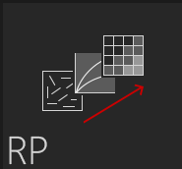
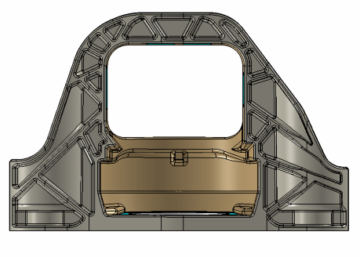
Sokaris Solution using Digimat
CAO
OPTIMISATION
PROCESS SIMULATION + DIGIMAT + FE ANALYSIS
PROCESS SIMULTATION
CAO
DIGIMAT RP
OPTIMISATION
DESIGN
1) UPLOAD MODEL
2) SELECT MATERIAL
ESTIMATE FIBERS ORIENTATION
Digimat RP solution:
Performance analysis of reinforced plastics available in 4 clicks
Provide structural engineers an easy and efficient solution to access fiber orientation
Boost the efficiency of early design → 1h30 from fiber estimation to failure indicator (Abaqus coupling)
→ Make several design & process iteration in a day!
4) RUN FE COUPLED ANANYSIS

Slide 4
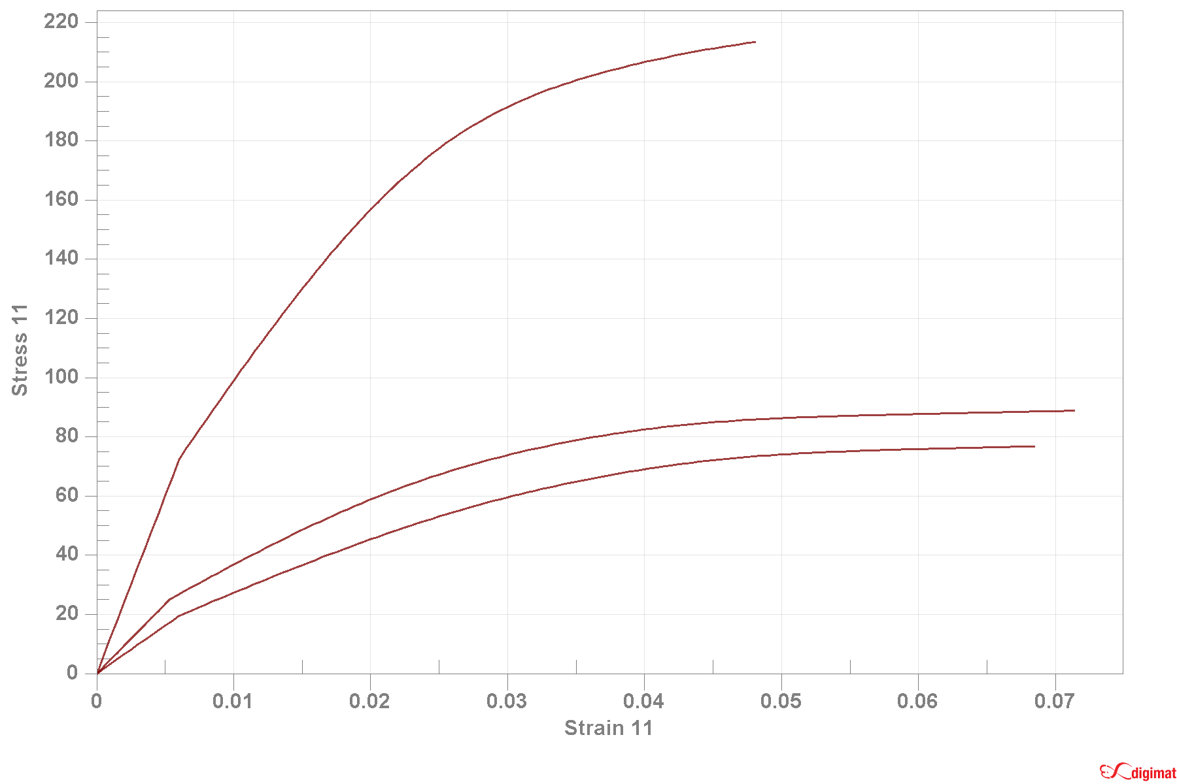
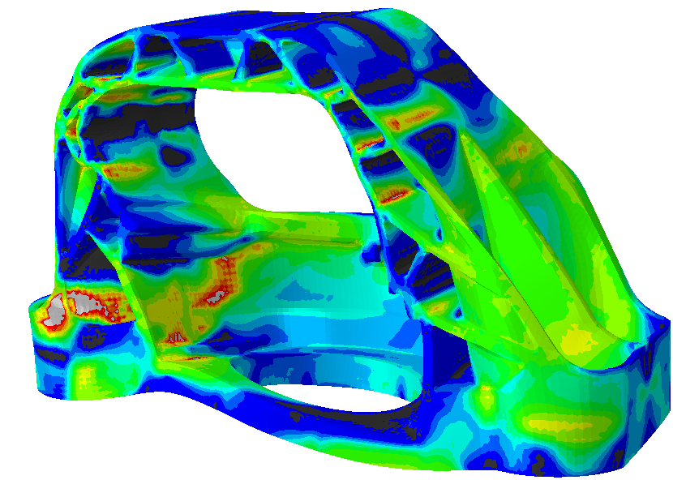
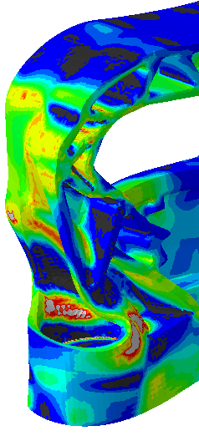
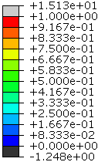
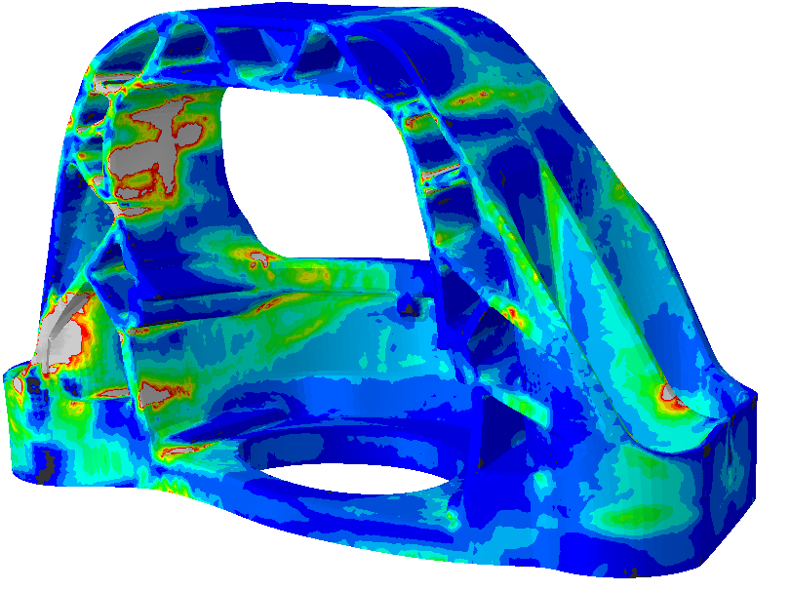
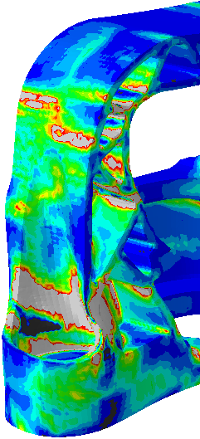
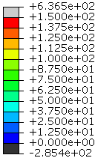
Results / benefits
Isotropic approach without DIGIMAT
Anisotropic approach with DIGIMAT
Abaqus
FEA model
Abaqus
FEA model
Digimat
material model
Digimat
fiber orientation
0°
45°
90°
Digimat to Abaqus
anisotropic results
Max. principal stress
Failure indicator
Local fiber orientation highly influences part performance and failure: Digimat to Abaqus solution shows a different stress, strain level and different failure evolution due to the material anisotropy.
The anisotropic analysis taking into account injection molding able to anticipate weakness areas and provide some optimization perspective.
Using Digimat RP with fiber orientation estimator module ensure:
Shorten development cycle by integrating anisotropic data and rheological simulations at the early phase of the project.
Account for the effects of injection molding and tune weldline positions
Easy and accurate anisotropic simulation solution to deployed and used by any engineers

Slide 5
Synthesis Slide

Slide 6
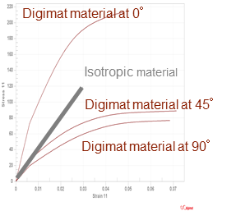
Sokaris Short Fiber Reinforced Plastic engine mount: → fast and accurate design loop with Digimat
CAO
OPTIMISATION
PROCESS SIMULATION + DIGIMAT + FE ANALYSIS
PROCESS SIMULTATION
CAO
ANISOTROPIC SIMULATION
load
OPTIMISATION
DESIGN
INJECTION (FILLING)
FIBER ORIENTATION
DIGIMAT SIMULATION: 1h30 from fiber estimation to failure indicator (Abaqus coupling)
FE ANALYSIS
DIGIMAT Benefits !
The local fiber orientation highly influences the part performance and failure.
The Digimat to Abaqus solution shows a different stress and strain level and failure evolution due to the material anisotropy.
Easily compute an estimation of the fiber orientation with DIGIMAT-RP
Shorten development cycle by integrating anisotropic data and rheological simulations at the early phase of the project.
Max. principal stress
ISOTROPIC SIMULATION : maxi. principal stress
Overdesign ? Failure risk?

